Slide 1
Wabash Capstone Project Notes 07
By: John Danison

Slide 2
What Did I Say I Would Do This Week?
Continue to support lab testing as requested.
Continue to develop data offloading software.

Slide 3
What I Have Done Over The Past Week
Performed lab testing on Kingpin assembly and on steel cutout.
Added features to Wabash data offloading software.
Attended meetings and class.
Updated schematics and recorded Gate 5.5 presentation.

Slide 4
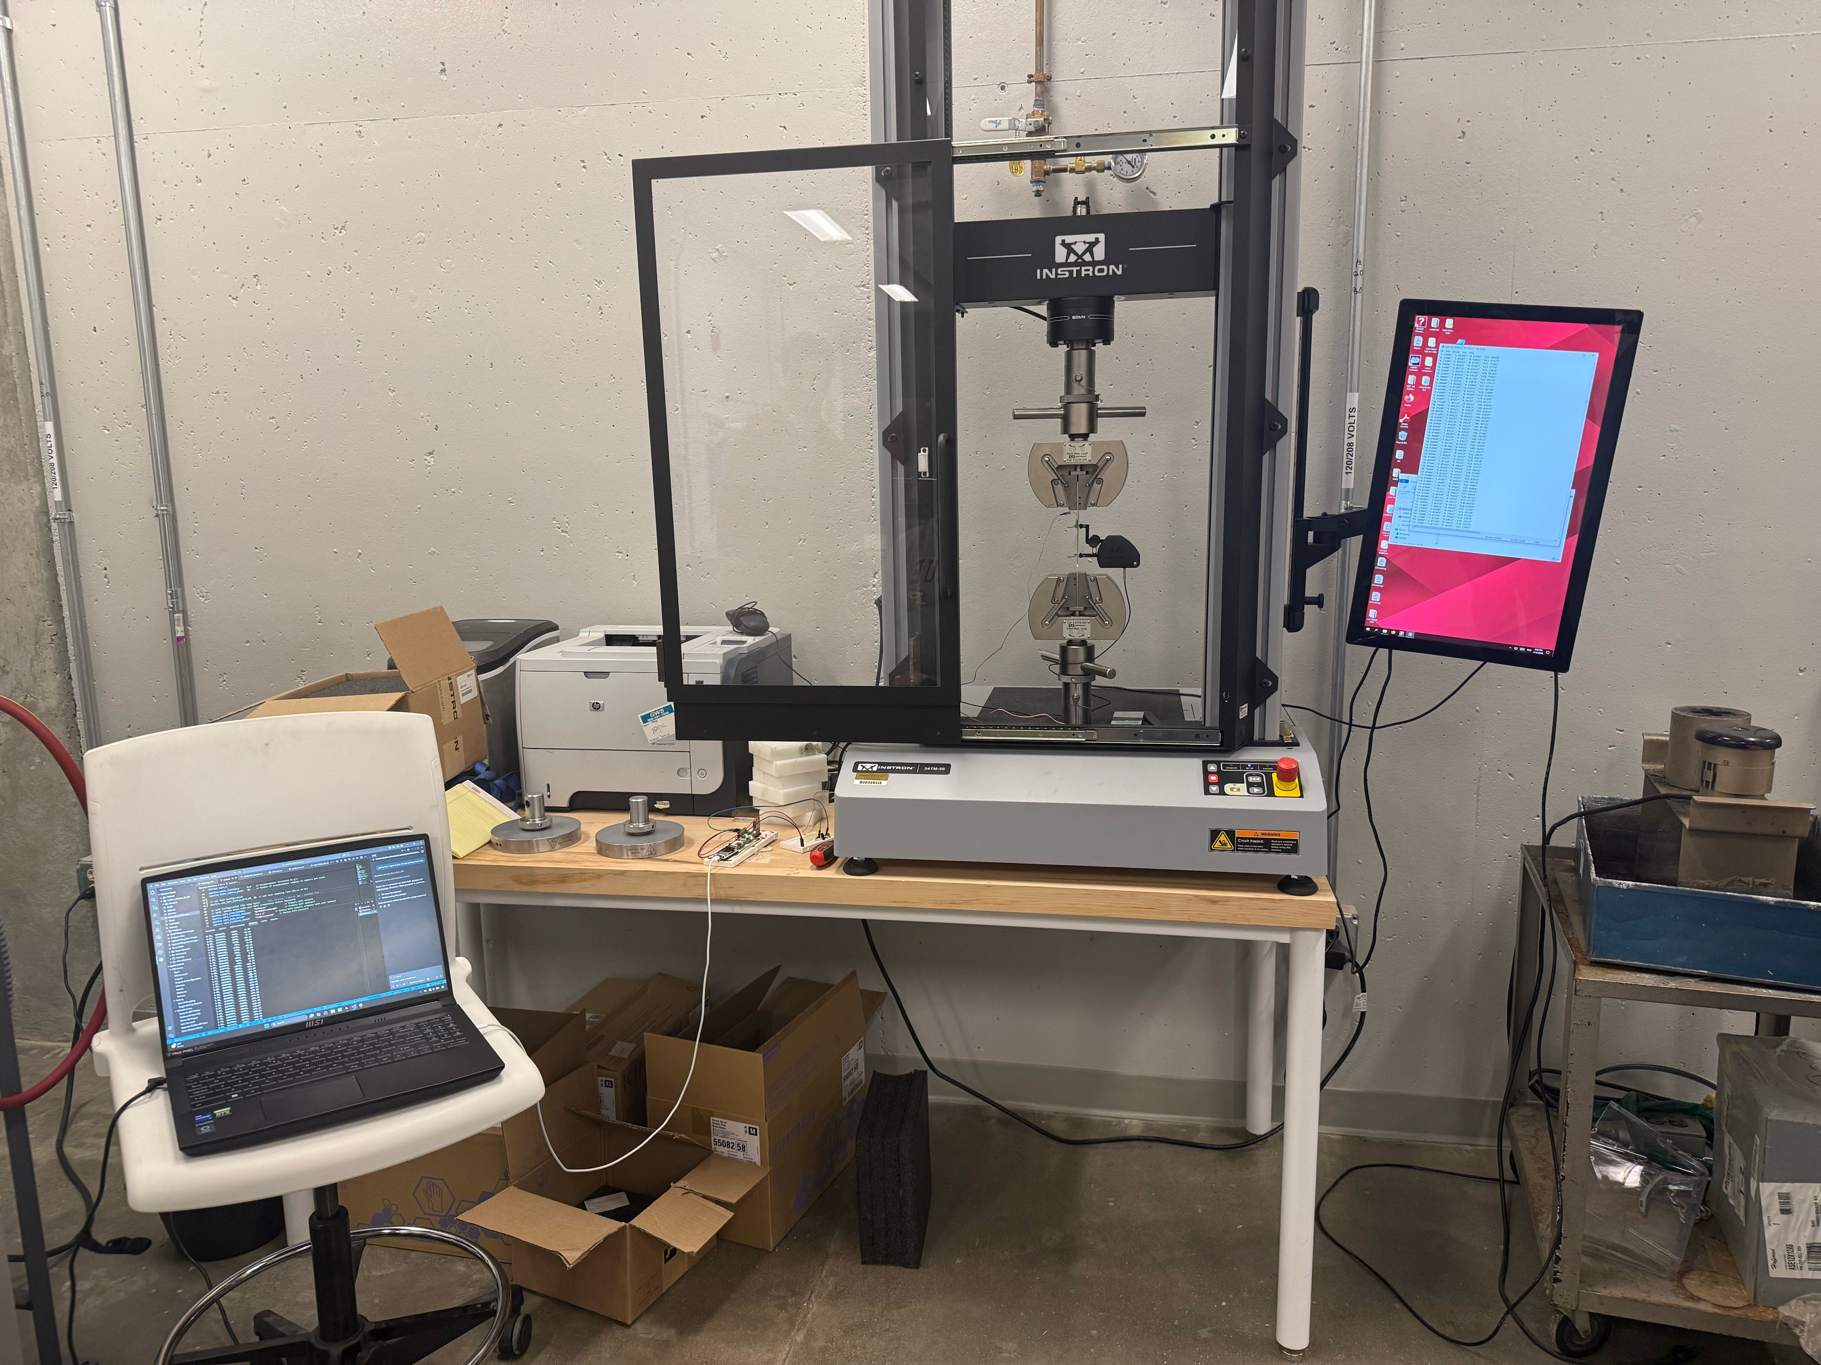
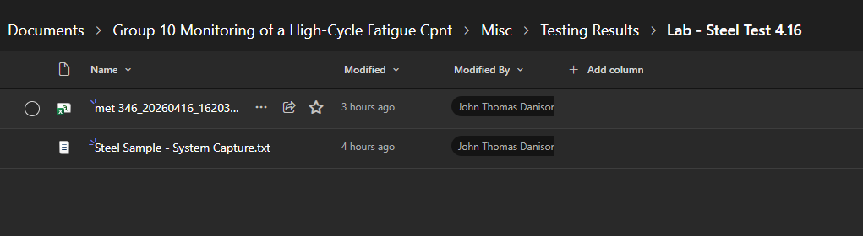
Lab Testing – Dudley UTM Machine

Slide 5
Wabash Software Updates

Slide 6
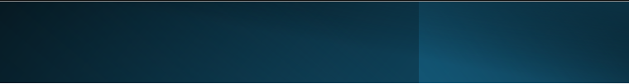
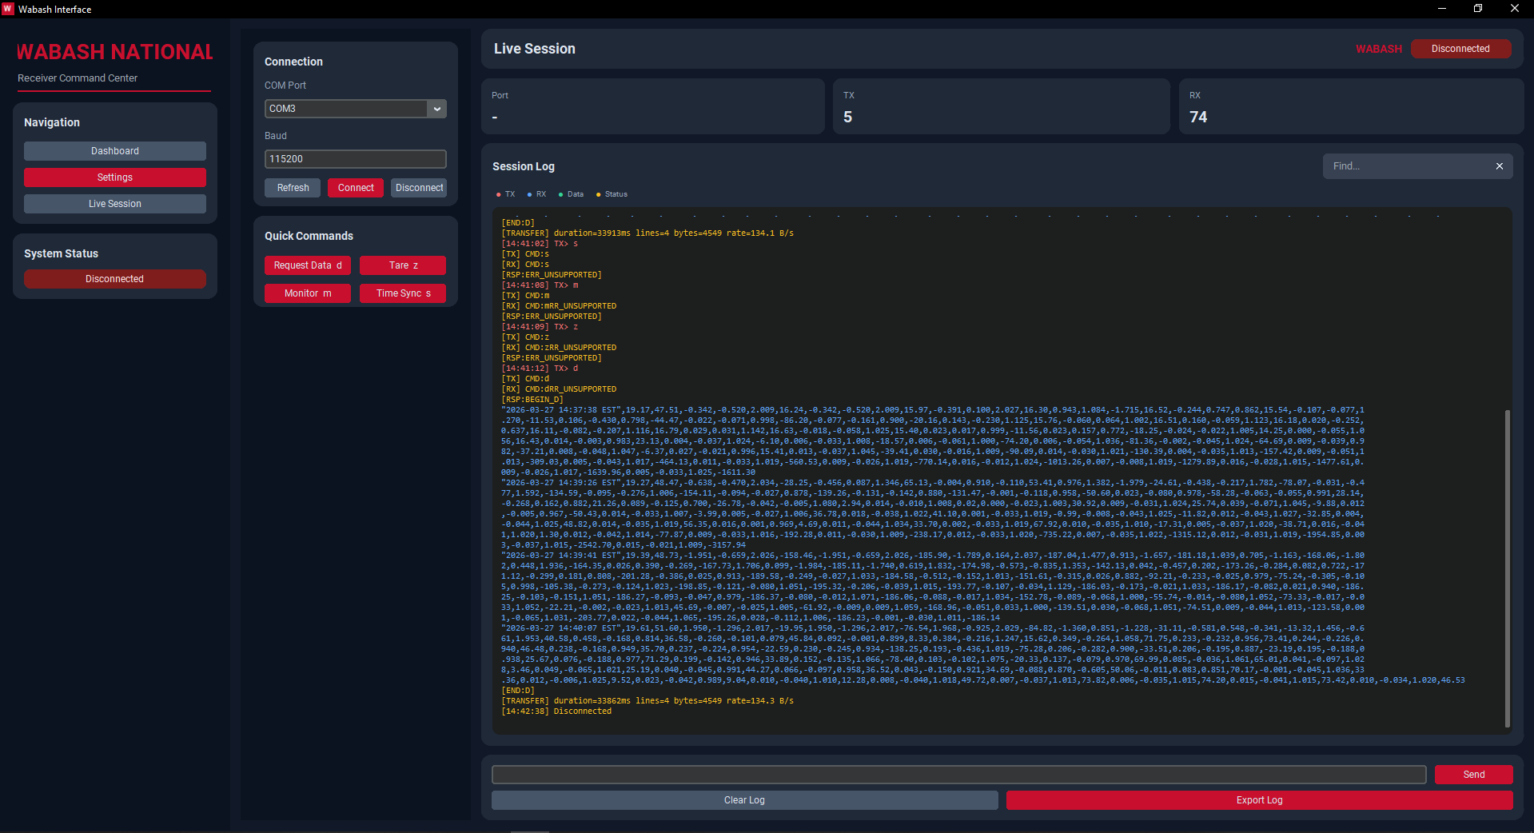




Wabash Software Updates
Initial Presentation: 3/27

Slide 7
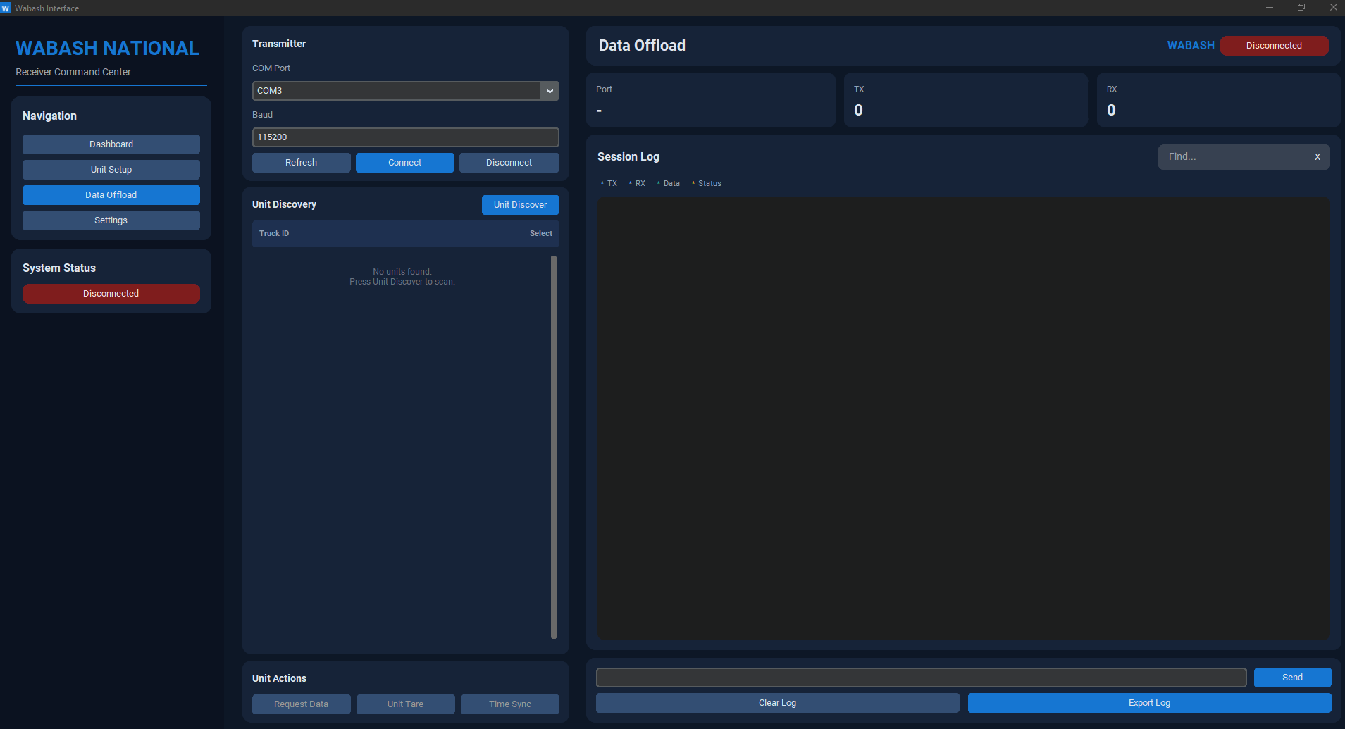
Wabash Software Updates
Presented: 4/10

Slide 8
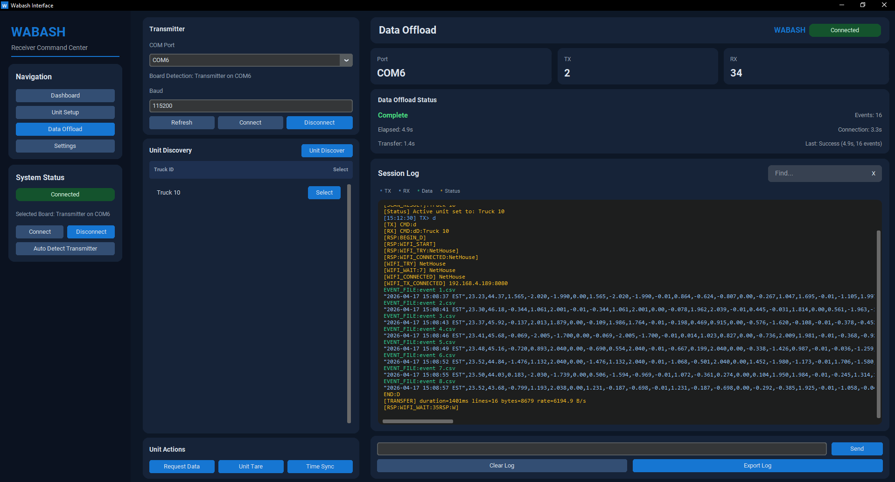
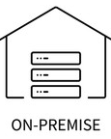
Wabash Software Updates
Current Version

Slide 9
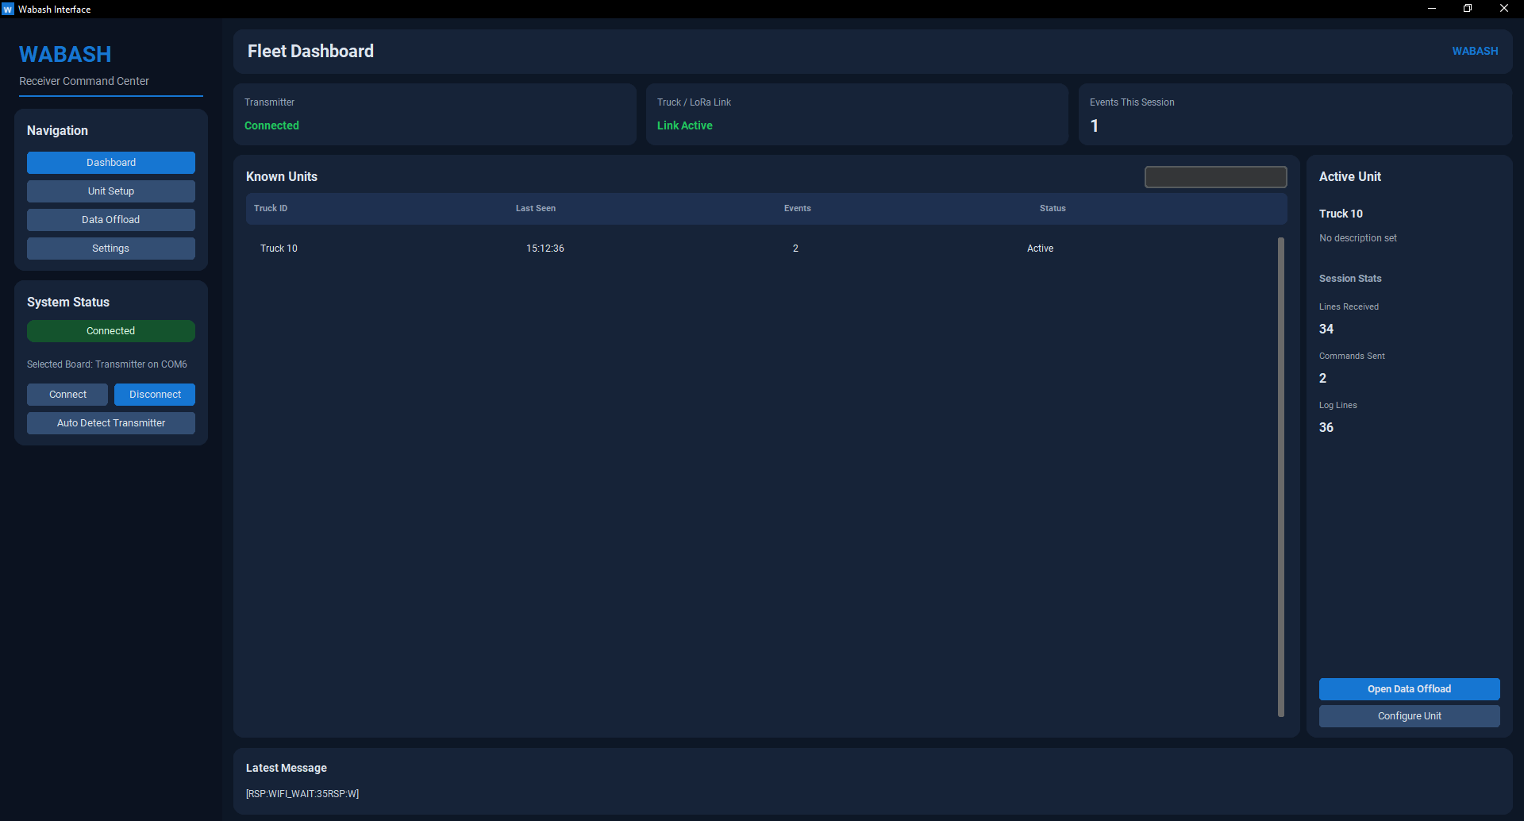
Wabash Software Updates

Slide 10
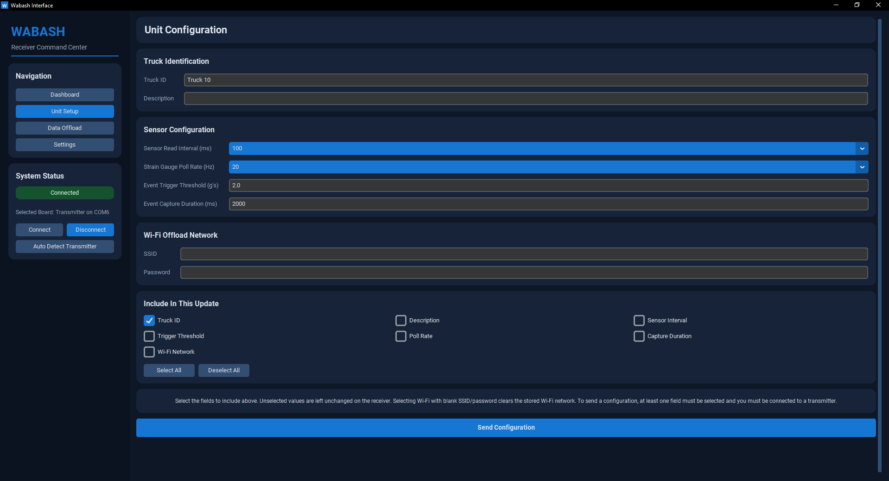
Wabash Software Updates

Slide 11
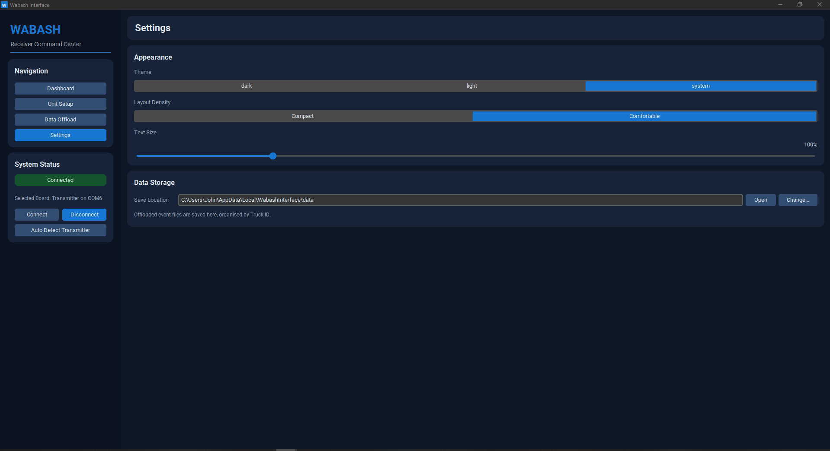
Wabash Software Updates

Slide 12
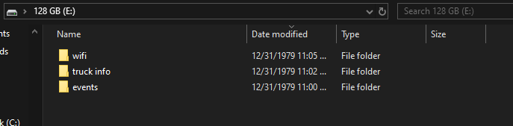
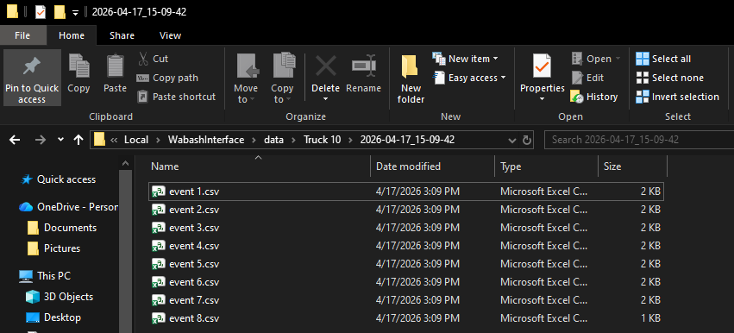
Wabash Software Updates
SD Card Setup:
App Data Local Storage

Slide 13
Wabash Software Updates
Demo Video can be found at the end of the Gate 5.5 presentation submission.
The video was giving me issues here unfortunately.

Slide 14
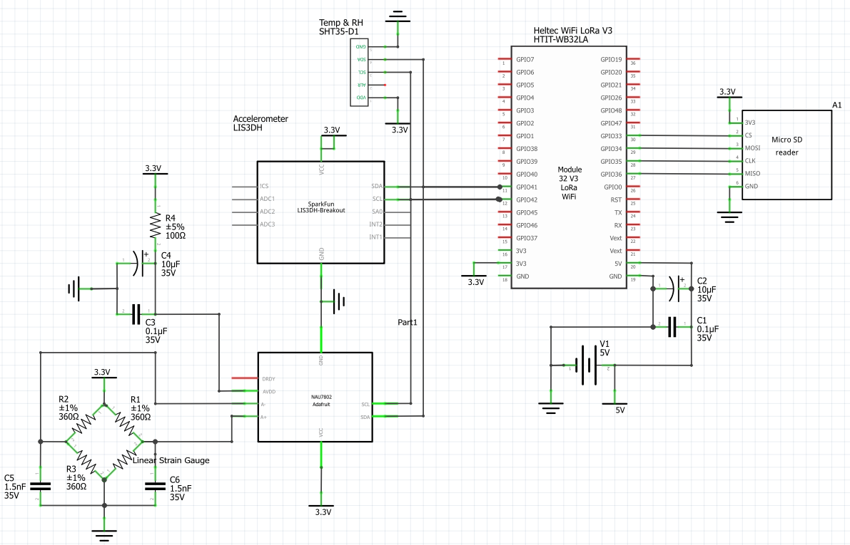
Schematic Update – Added Capacitors

Slide 15
Did I Do What I Say I Would Do?
I feel that I accomplished everything that I said I would do over these past couple weeks.
The data offloading software is well under development is still going well.
I attended all lectures, labs, and meetings w/ the client.

Slide 16
Plans For Upcoming Weeks
High Level
By EOW:
Continue to develop data offloading software.
Continue to show up to class.
Continue to support lab testing as requested by the team.
Continue to add client feature requests in data offloading software.

